Slide 1
Microsoft Cognitive Toolkit
[ Instructor Name ]
[ Instructor E-mail ]

Slide 2

“The Microsoft Cognitive Toolkit —previously known CNTK — empowers you to harness the intelligence within massive datasets through deep learning by providing uncompromised scaling, speed, and accuracy with commercial-grade quality and compatibility with the programming languages and algorithms you already use. “
Notes:
The Microsoft Cognitive Toolkit, formerly known as CNTK, is a powerful set of utilities for machine learning. Microsoft developed a cohesive set of tools that bring together under one roof things that researchers and scientists use to perform their tasks more quickly and efficiently. It includes a number of libraries and utilities for speech, image, language, and video recognition and many examples on how to use these tools. It can use CPU’s and GPU’s and is the basis for Skype, Cortana, Bing, Xbox and many other commercial grade products.

Slide 3
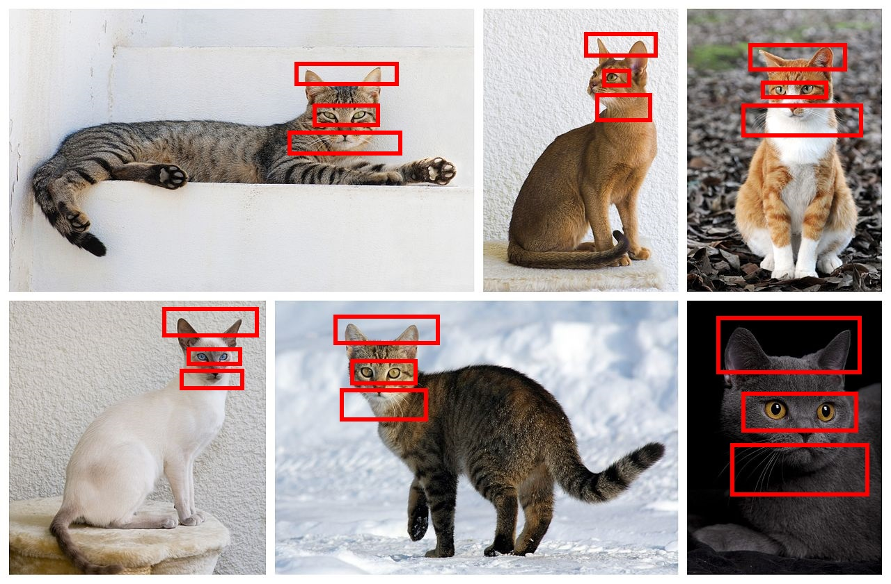
The problem…
Writing algorithms to find patterns in data is difficult and requires logic specific to the task at hand. An algorithm to identify cat images might look for pointed ears, slit pupils, and whiskers.
Machine learning offers a solution. Train a model with millions of cat images, and the model can "learn" to identify cats.
Notes:
Imagine trying to write an algorithm to identify a cat. Traditional algorithms would need to look for features in the image to determine whether or not what was in the image was indeed a cat or not a cat, such as pointed ears, whiskers, and slit pupils in the eyes instead of round pupil. Machine learning can be applied to solve this problem. Algorithms in machine learning look for patterns in images that are marked as cats and then when an unknown image is given, the machine can use the patterns abstracted from the known images to determine whether or not an unknown image is indeed a cat.

Slide 4
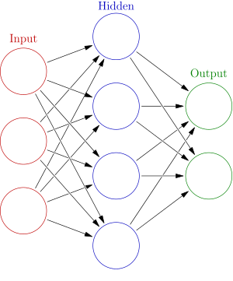
What is a Neural Network?
Neural networks solve problems the way the human brain solves problems
A neural network has multiple input nodes that feed into “hidden” nodes along weighted edges. If the sum of inputs meets a specific threshold, a “hidden” node will output true or false, then feed this input into more nodes, and so on until they reach output nodes.
Notes:
Machine learning enables computers to perform tasks that would otherwise be difficult to do with standard algorithms, such as image recognition. A Neural Network is a set of connected nodes that mimics the biological analog in a brain. A neural network is capable of “learning” to recognize patterns in a set of input data. The input data is of known types which are fed into a neural network. The data is decomposed into smaller subsets and are fed into **input nodes** on a neural network. These nodes are connected to many **hidden nodes** on the network via probabilistic edges. The input region is determined to have a particular value, which is mathematically processed by probability of an edge along with input from other nodes. The nodes then feed into other nodes until they reach the **output nodes**. If the probability output node is a certain level, it will identify something as a cat or something else entirely.

Slide 5
Microsoft Cognitive Toolkit
Free and open-source
Works with CPUs and GPUs and scales to multiple machines
Includes prebuilt algorithms for implementing neural networks
Supports Python, C++, R, and C#
Can be used with Power BI or and Azure (including Azure GPUs)
.cntk files define parameters for training and testing neural networks
</>
Notes:
The Microsoft Cognitive Toolkit is a robust set of tools that enables developers and scientists of all kinds to take advantage of deep learning with neural networks. Microsoft has made the API available in many popular programming languages, particularly C++, Python, R, and C#. The toolkit also allow for cloud connectivity with things like Power BI and Azure. The nexus of possible integration points makes the toolkit accessible and available for many powerful applications.

Slide 6

Learning the Toolkit
The toolkit comes with a number of examples demonstrating how to use it to analyze speech, language, video, images, and more
With each of these examples, it provides utilities for getting sample data as well
Notes:
In an effort to make the Toolkit the more usable, Microsoft has included a number of examples, tutorials, and hands-on labs. Many of these labs come with sets of sample data or utilities to get the sample data. Also, Microsoft has provided a model gallery online that has a number of pretraining models for use as well with the accompanying code, examples, and tutorials. These can be found at https://www.microsoft.com/en-us/research/product/cognitive-toolkit/model-gallery/ and downloaded for use with the Toolkit.

Slide 7
Hands-On Lab
Microsoft Cognitive Toolkit HOL.html
Notes:
In this lab, you will use the MNIST dataset to train and test a pair of neural networks to do handwriting recognition. Then you will use the trained models to identify handwritten digits. The MNIST dataset is one of the popular datasets for handwriting recognition. The database contains 60,000 images for the digits 0 through 9 taken from high school students. It also has a set of 10,000 test images. A number of scholarly papers have been published using this dataset, each one trying to improve neural networks such that there are more positives and less errors in the recognition of characters. Algorithms using the MNIST dataset apply the principle of breaking down each image of a handwritten character into regions, and then passing these into a neural network for processing.

